Slide 1
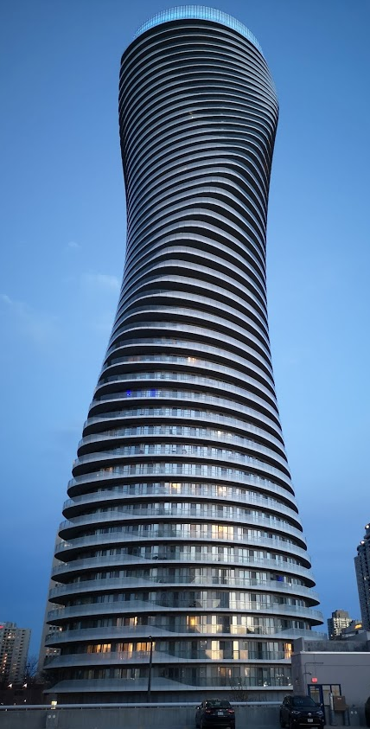
Teranet dataset
EDA results
Notes:
Growth centers
West Don Lands
Liberty village
Riverdale
Outline
Deadline to submit thesis
Month-by-month tuition

Slide 2
Section 1:
Distributions

Slide 3
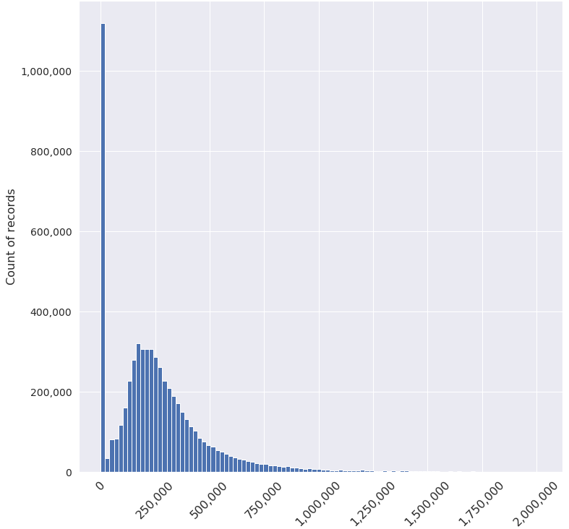
1.1.1: Distribution of price corrected to 2016
No bottom cut-off
Records with consideration amount above 2’000’000 CAD remain in the dataset, but have been excluded from this plot

Slide 4
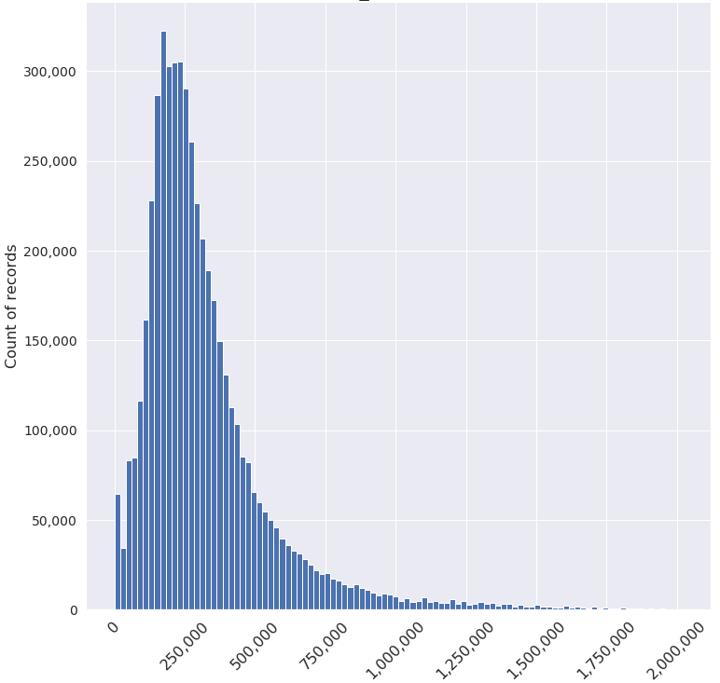
1.1.2: Distribution of price corrected to 2016
Records with consideration amount < 1’000 CAD have been removed
Records with consideration amount above 2’000’000 CAD remain in the dataset, but have been excluded from this plot

Slide 5
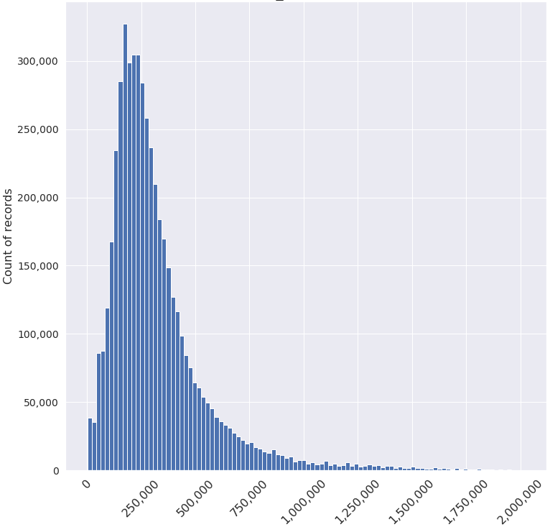
1.1.3: Distribution of price corrected to 2016
Records with consideration amount < 5’000 CAD have been removed
Records with consideration amount above 2’000’000 CAD remain in the dataset, but have been excluded from this plot

Slide 6
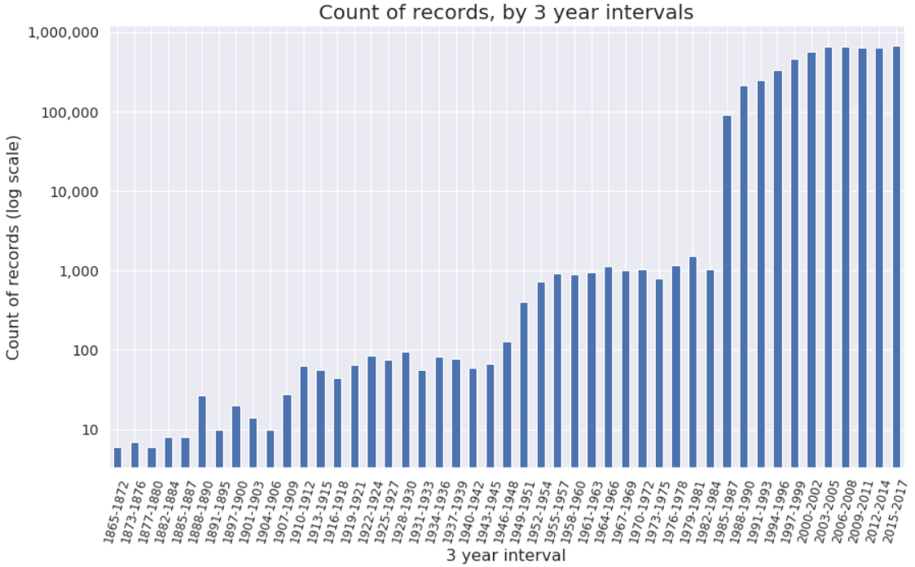
1.2: Distribution of count of records
Dramatic change in the count of records from 1984 to 1985

Slide 7
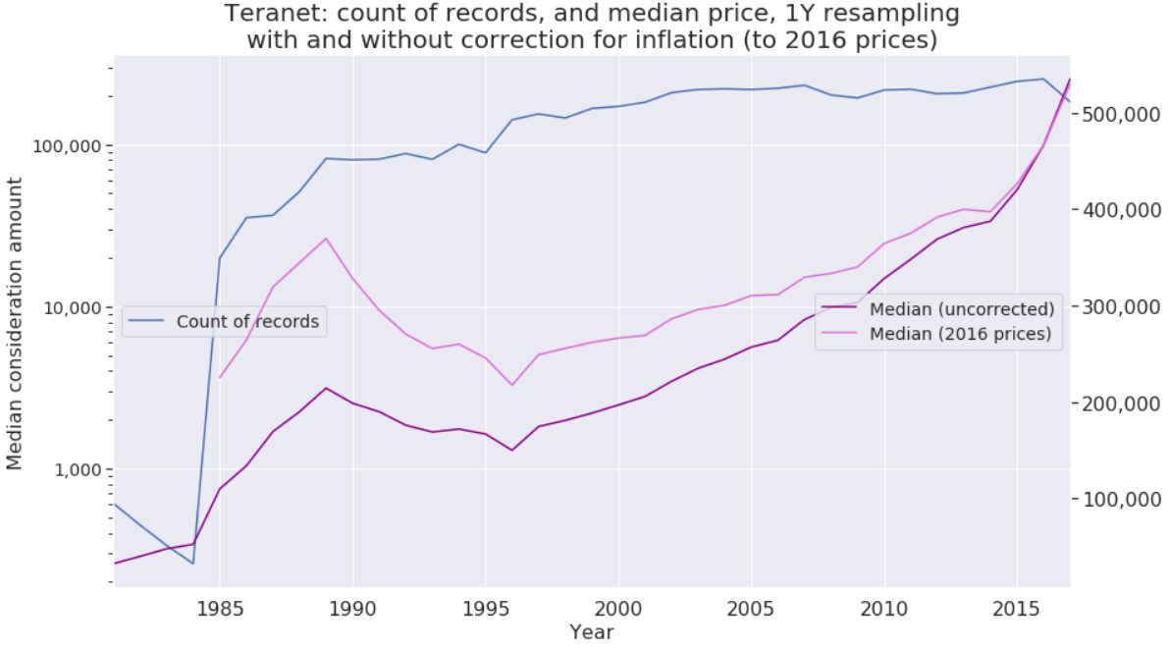
1.3: Median consideration amount
with and without correction for inflation (to 2016 prices)
YEAR | 1985 | 1986 | 1987 | 1988 | 1989 | 1990 | 1991 | 1992 | 1993 | 1994 | 1995 | 1996 | 1997 | 1998 | 1999 | 2000
Percentage change compared to 2016 prices (X) | 104.92 | 97.40 | 88.47 | 81.32 | 72.36 | 65.09 | 55.35 | 53.69 | 51.17 | 51.17 | 47.21 | 45.06 | 42.65 | 41.25 | 38.97 | 35.18
2001 | 2002 | 2003 | 2004 | 2005 | 2006 | 2007 | 2008 | 2009 | 2010 | 2011 | 2012 | 2013 | 2014 | 2015 | 2016 | 2017 | 2018 | 2019
30.80 | 29.23 | 25.95 | 22.84 | 20.77 | 17.90 | 15.37 | 11.87 | 12.16 | 11.10 | 7.76 | 6.17 | 4.96 | 2.54 | 1.49 | 0 | -1.00 | -3.37 | -5.28

Slide 8
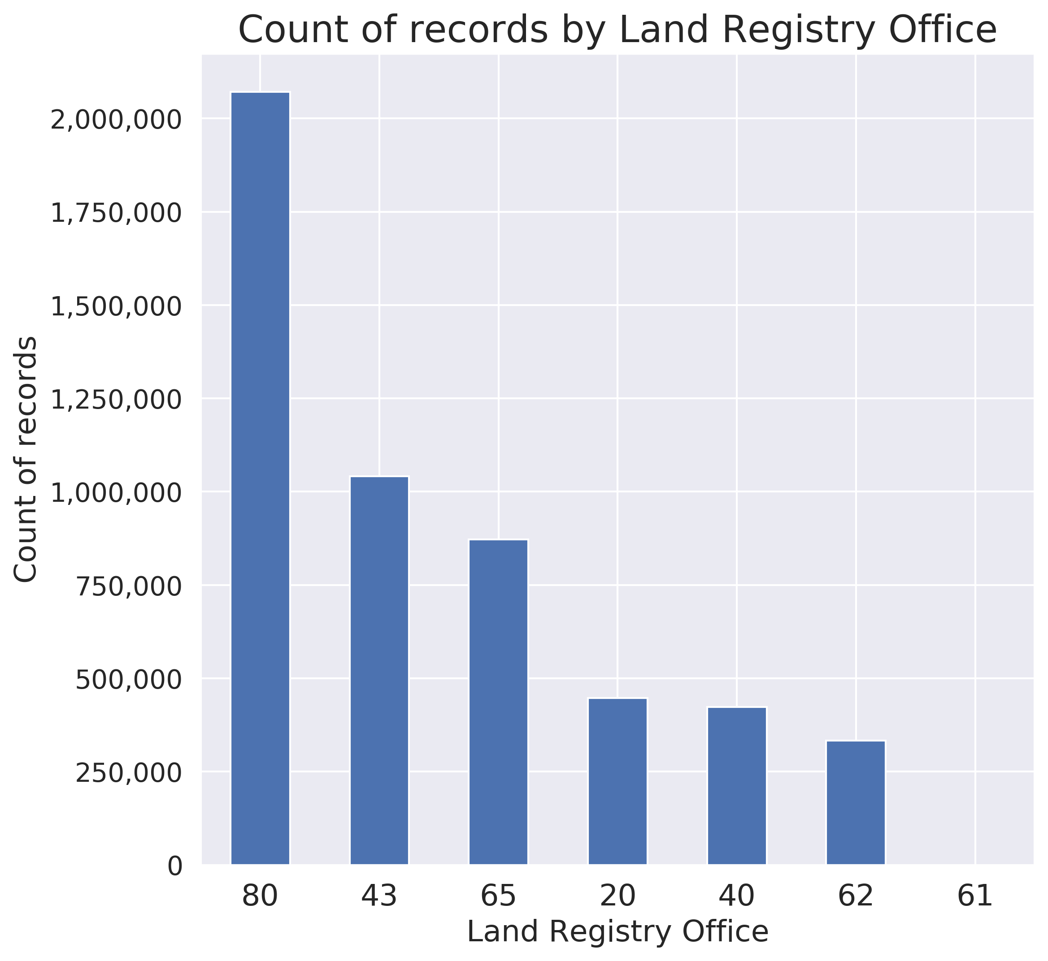
1.2: Distribution of count of records by LRO

Slide 9
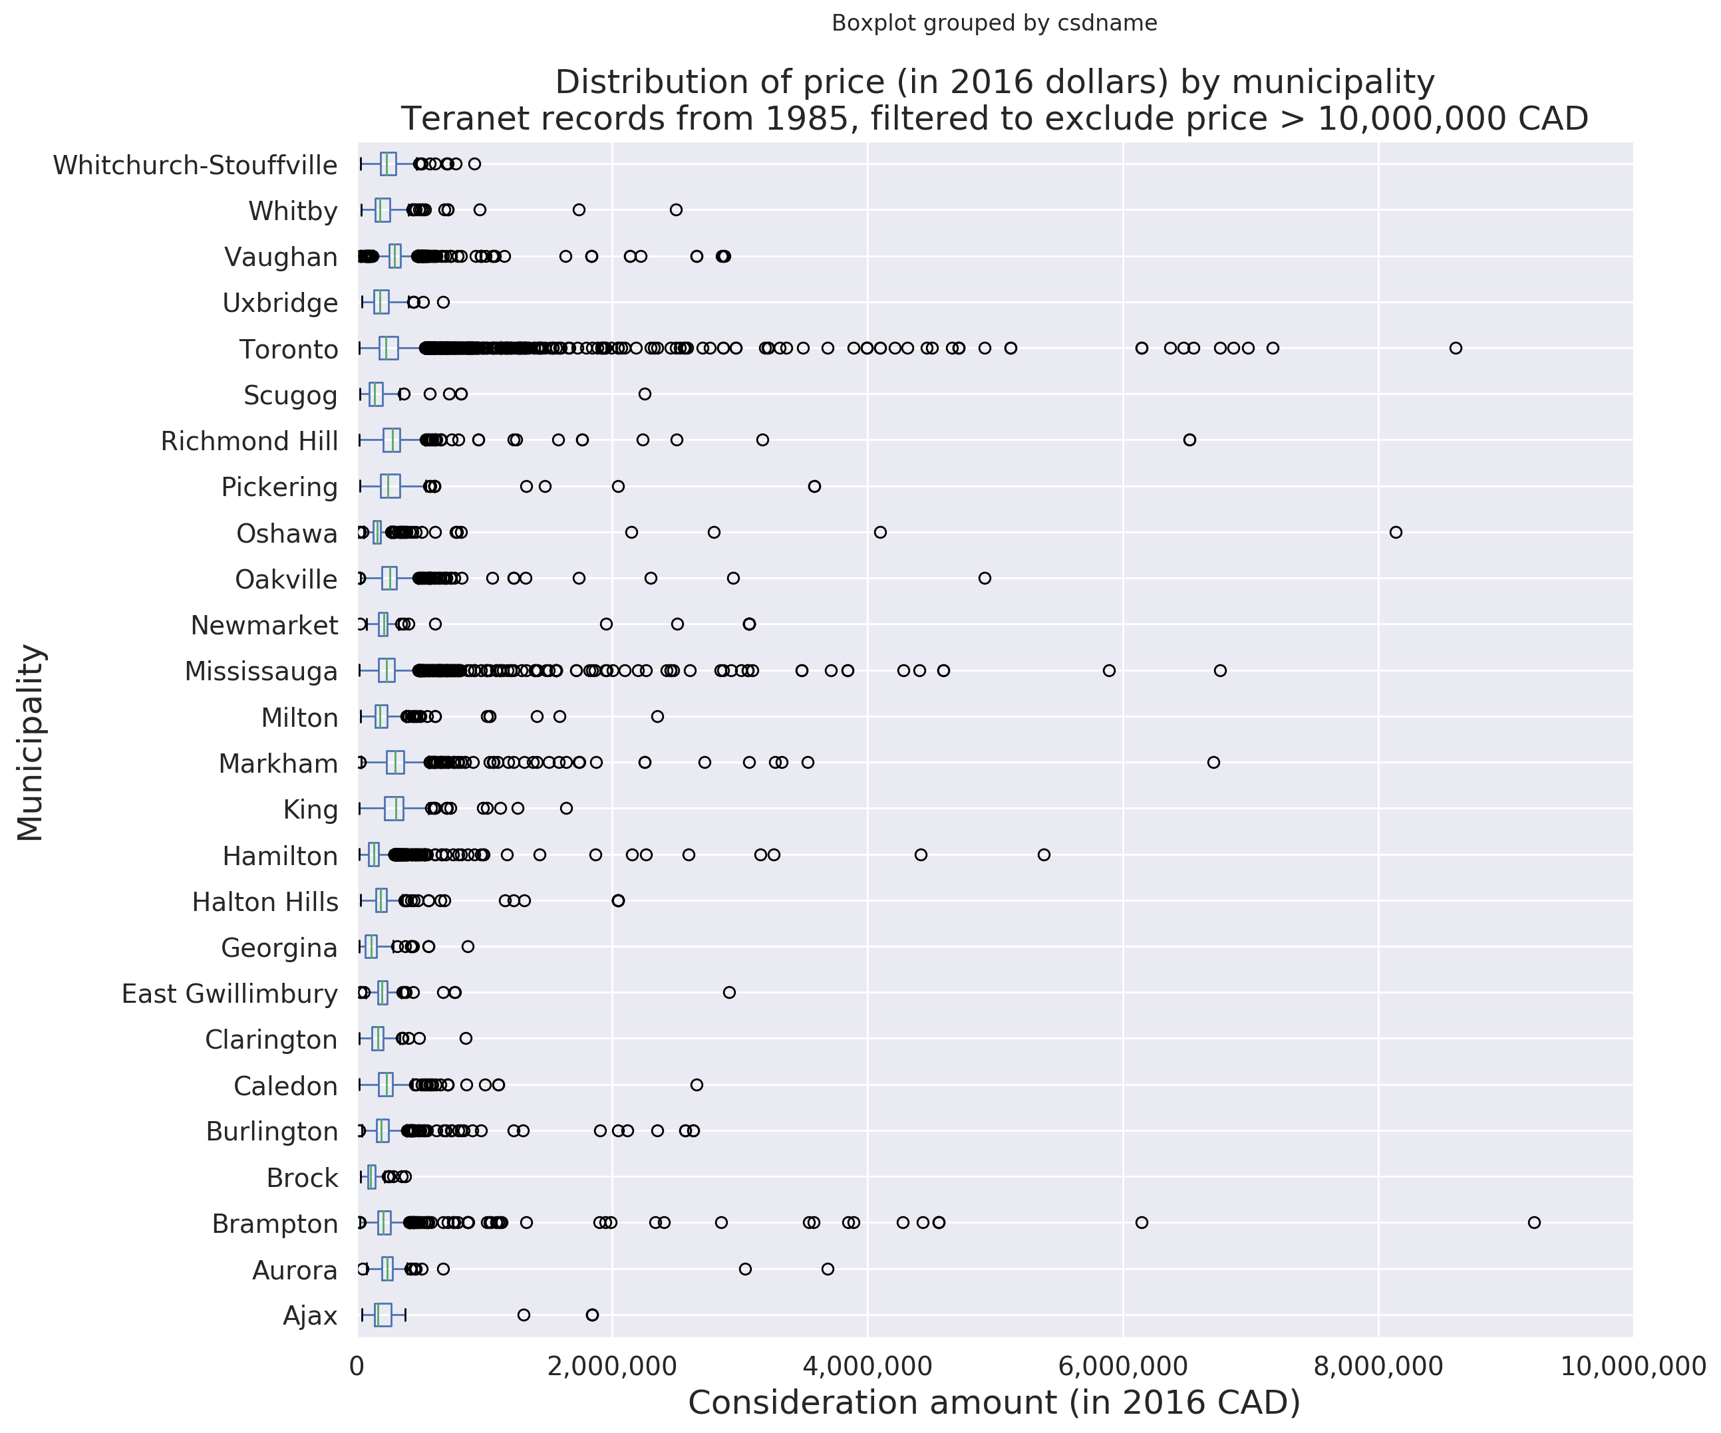

Slide 10
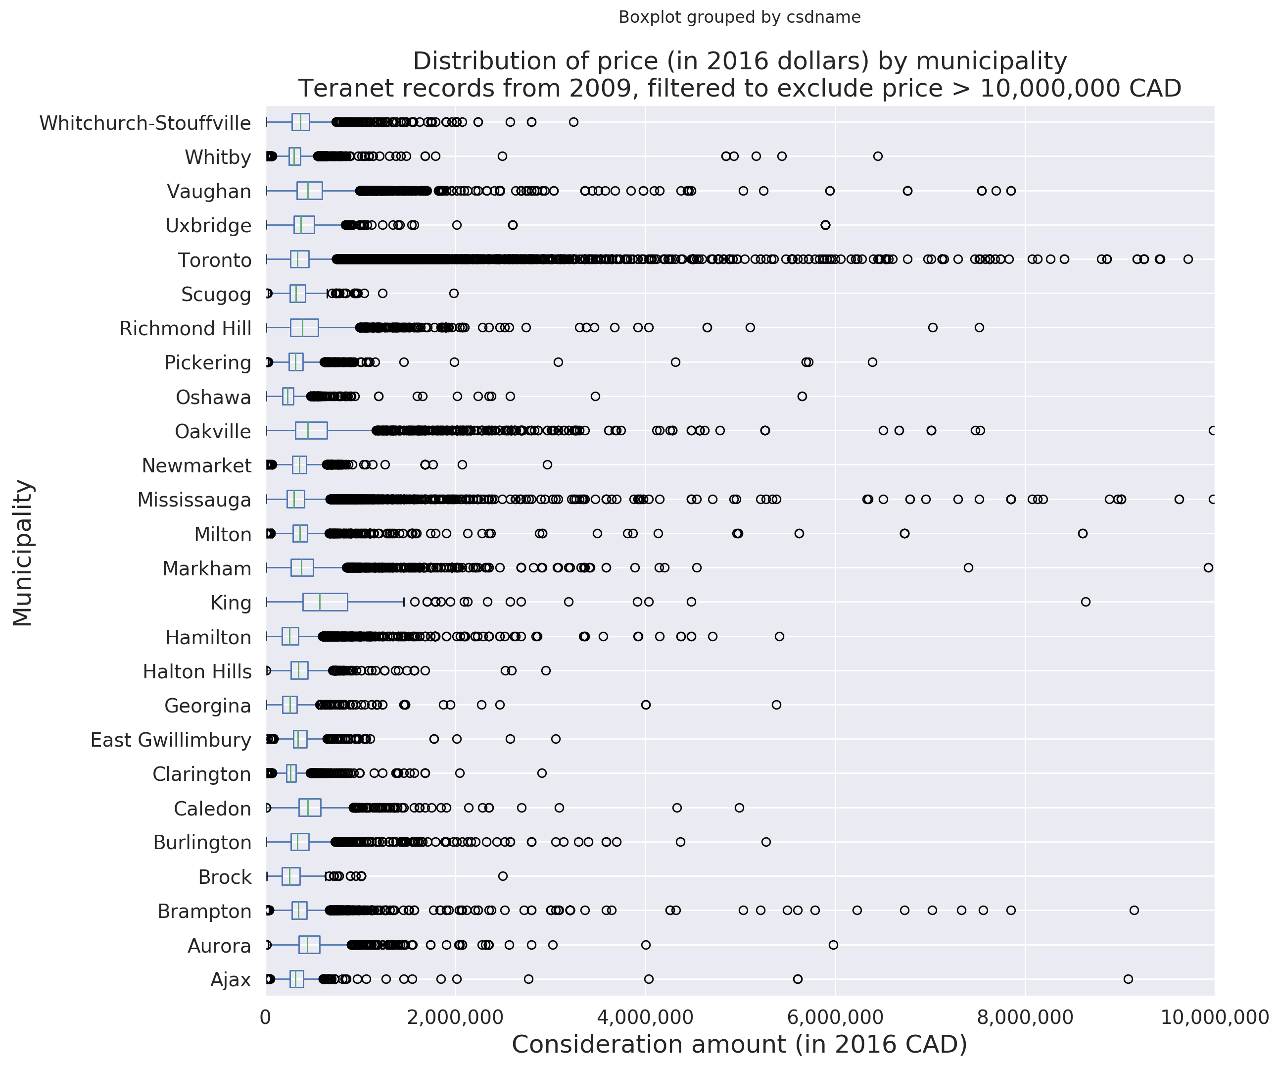

Slide 11
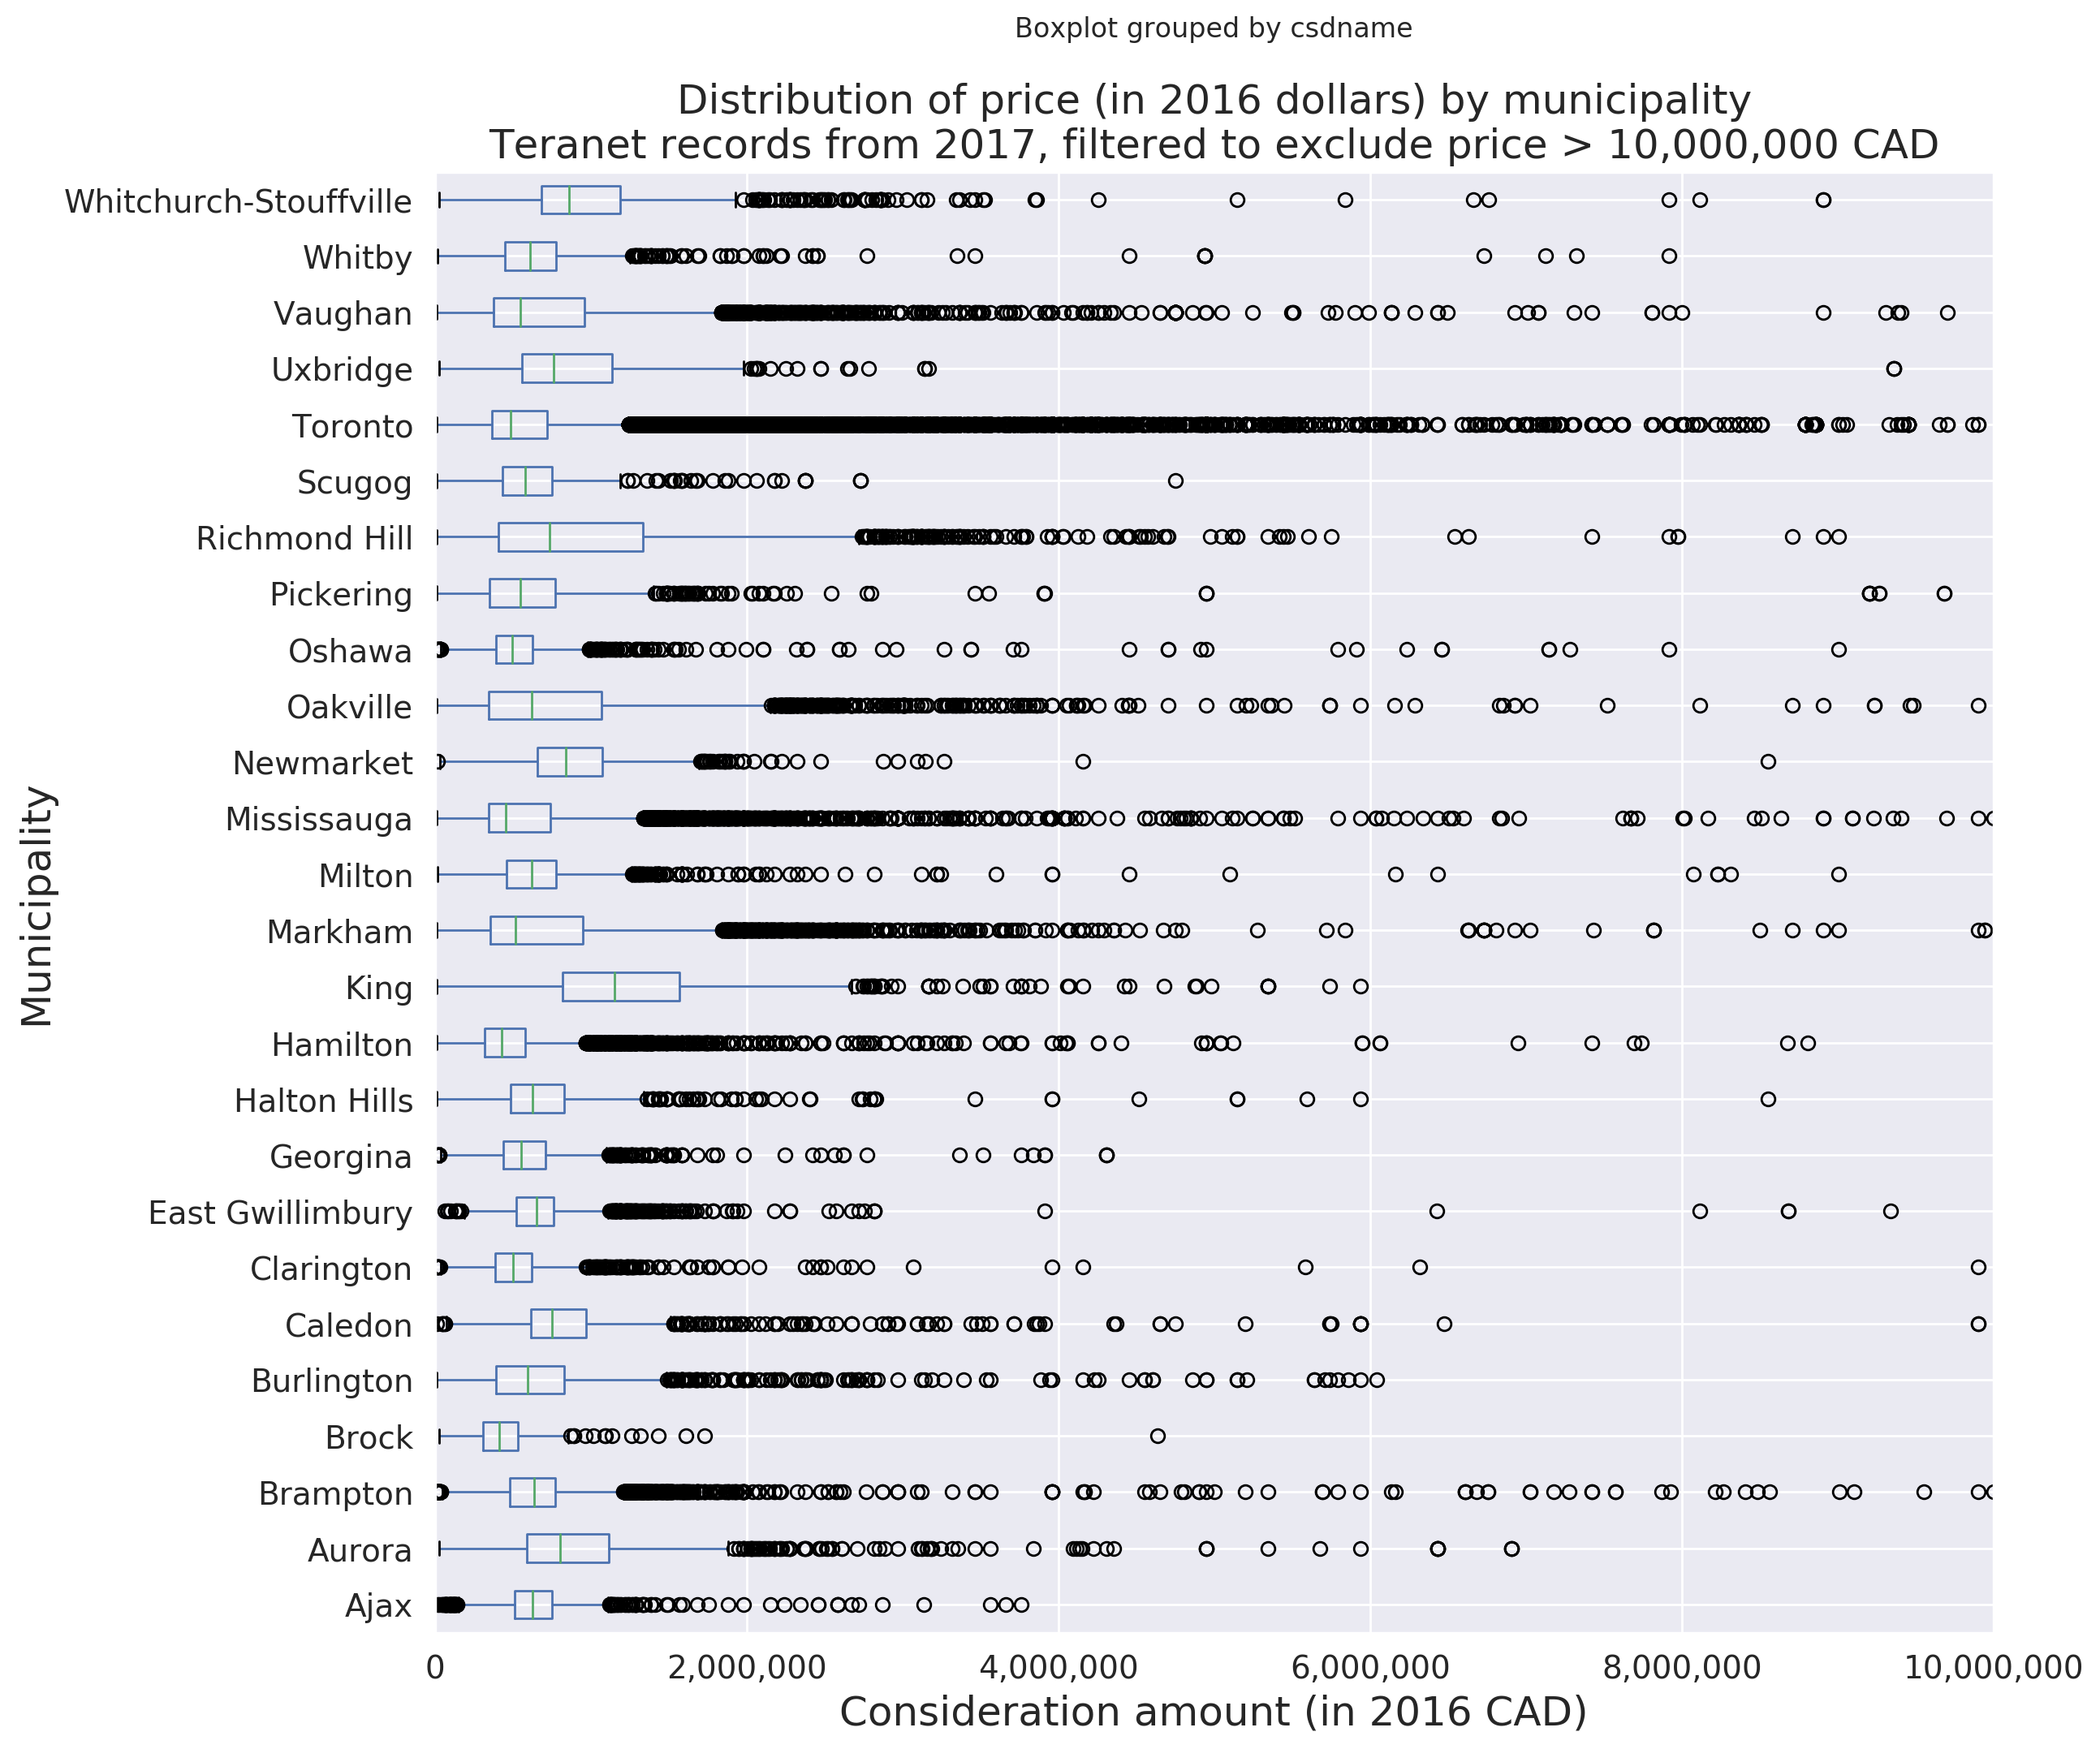

Slide 12
Section 2:
Large counts of records
by street name

Slide 13
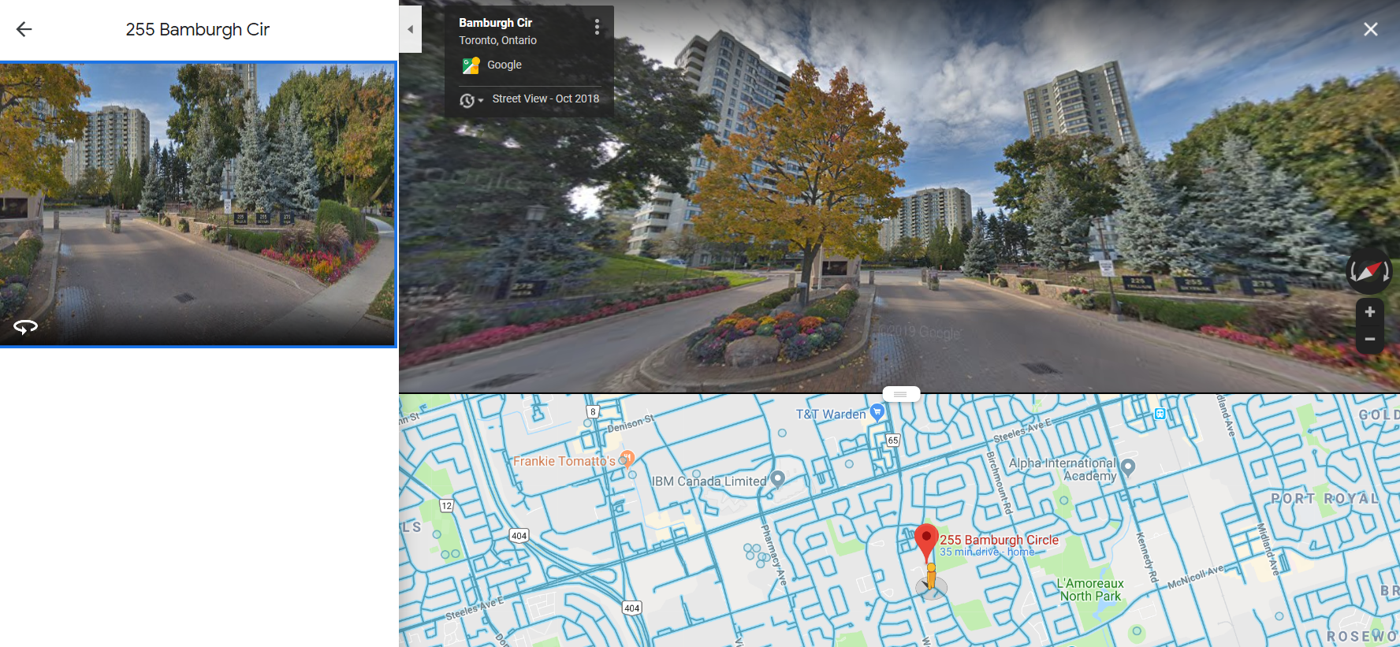
2.1: Bamburgh Cir, Scarborough

Slide 14
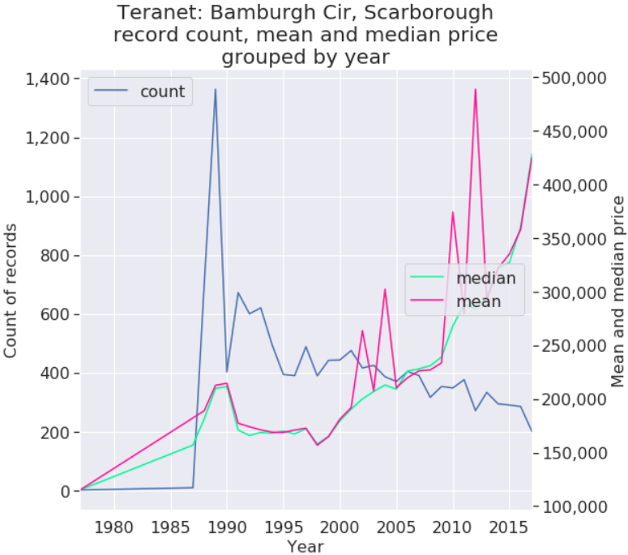
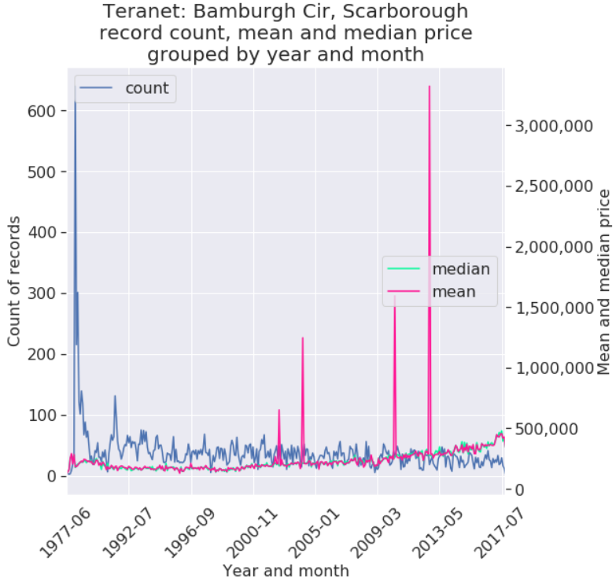
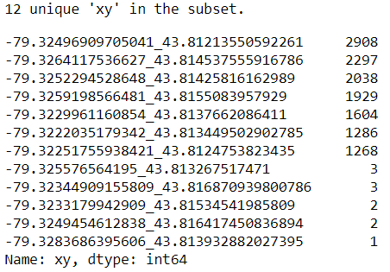
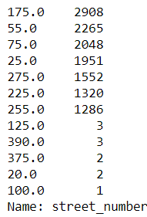
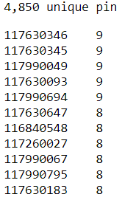
2.1: Bamburgh circle, Scarborough
Teranet record count
By street address:
By xy:
By pin:

Slide 15
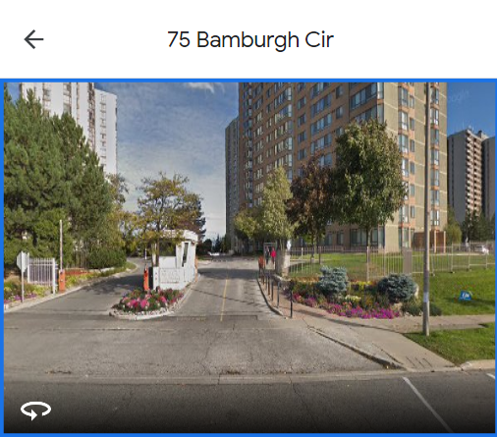
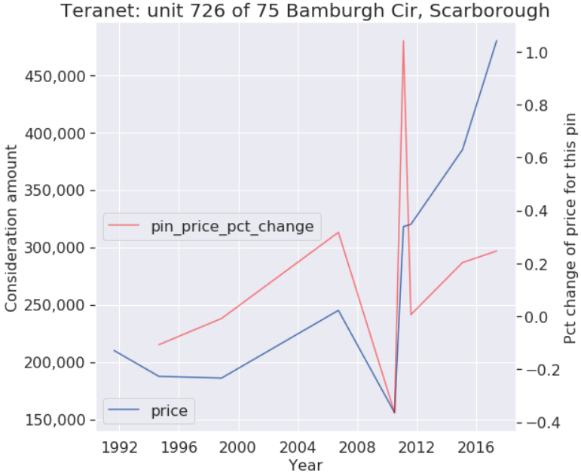
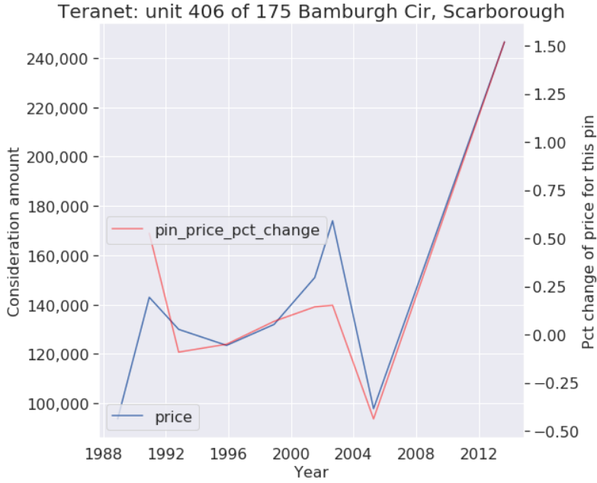
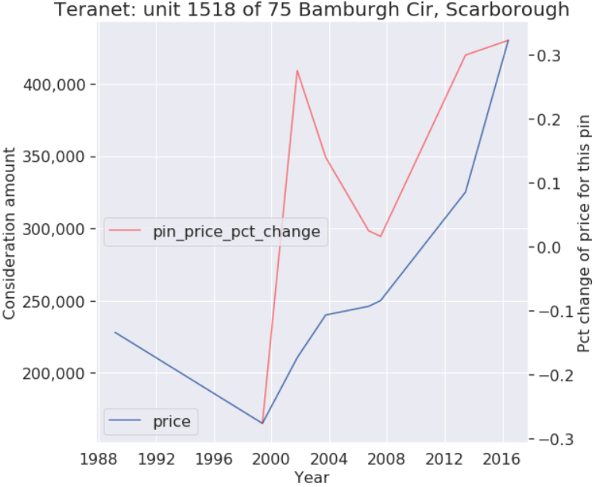
75 Bamburgh Cir, Scarborough individual unit sales

Slide 16
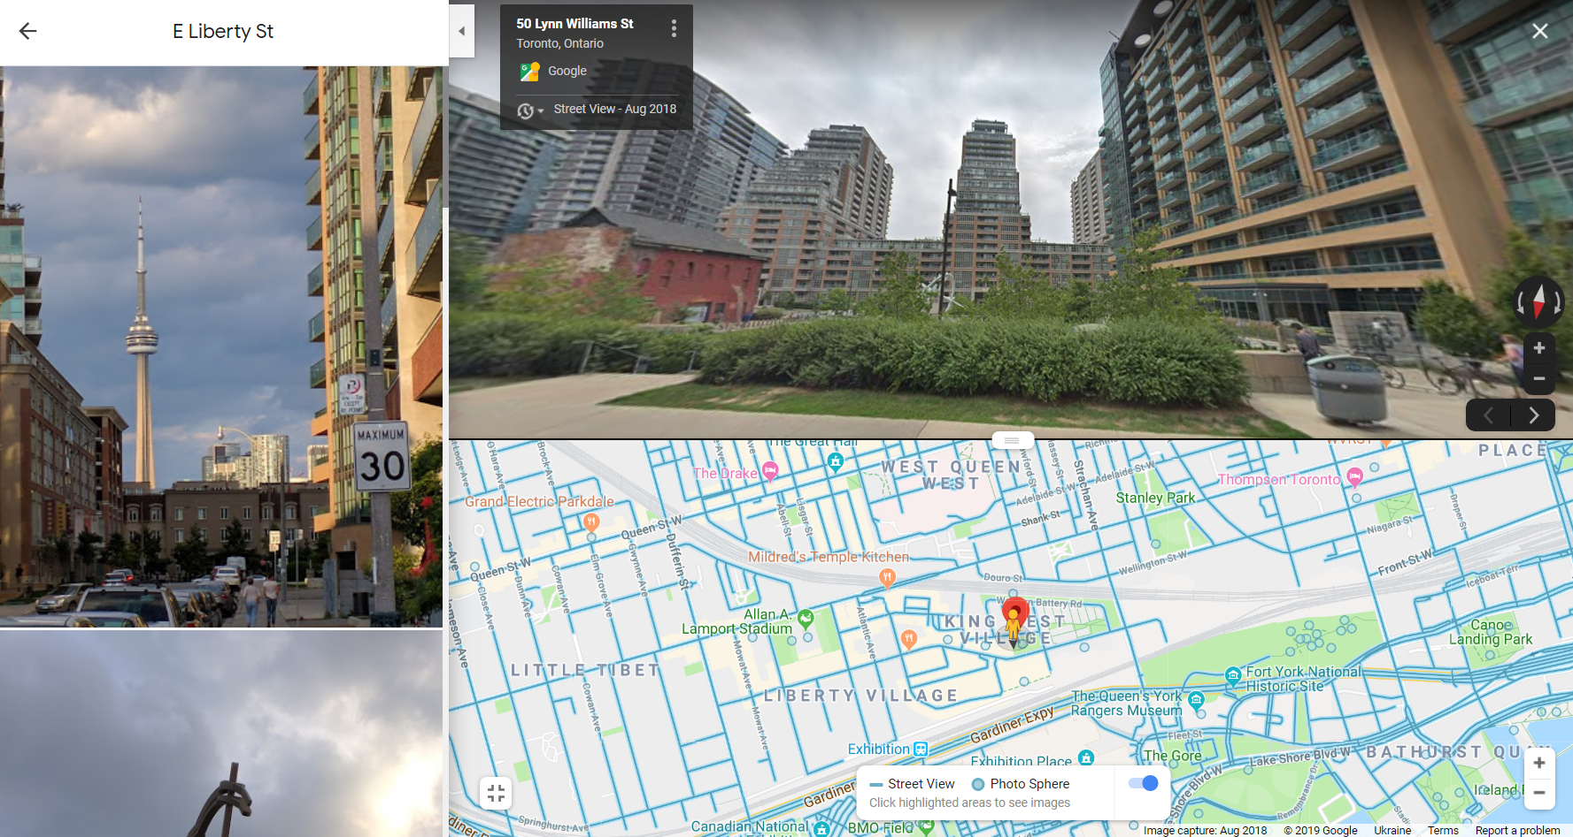
2.2: East Liberty St, Toronto

Slide 17
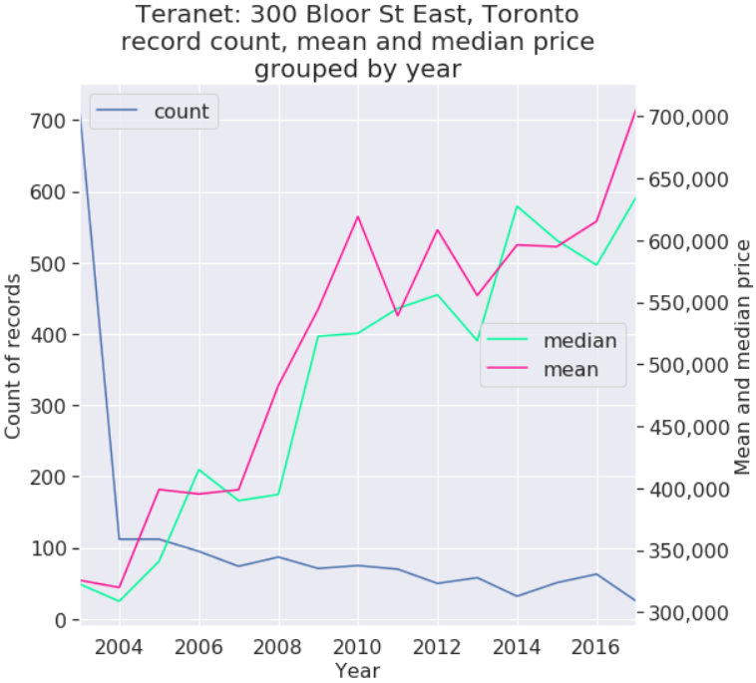
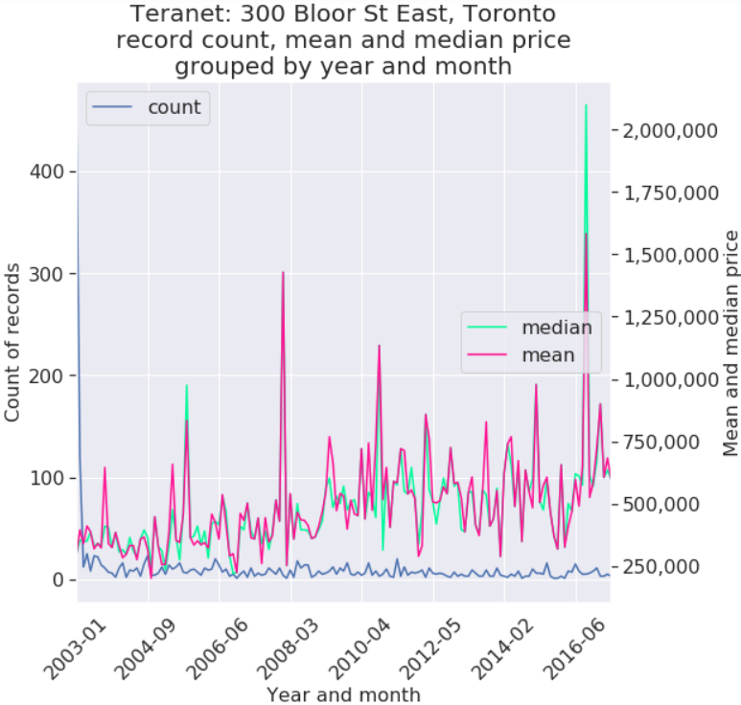
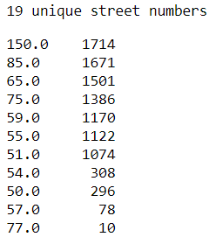
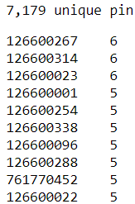
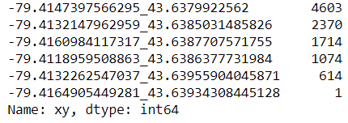
2.2: East Liberty St, Toronto
Teranet record count
By xy:
By street address:
By pin:

Slide 18
Section 3:
Large counts of records
by individual address

Slide 19
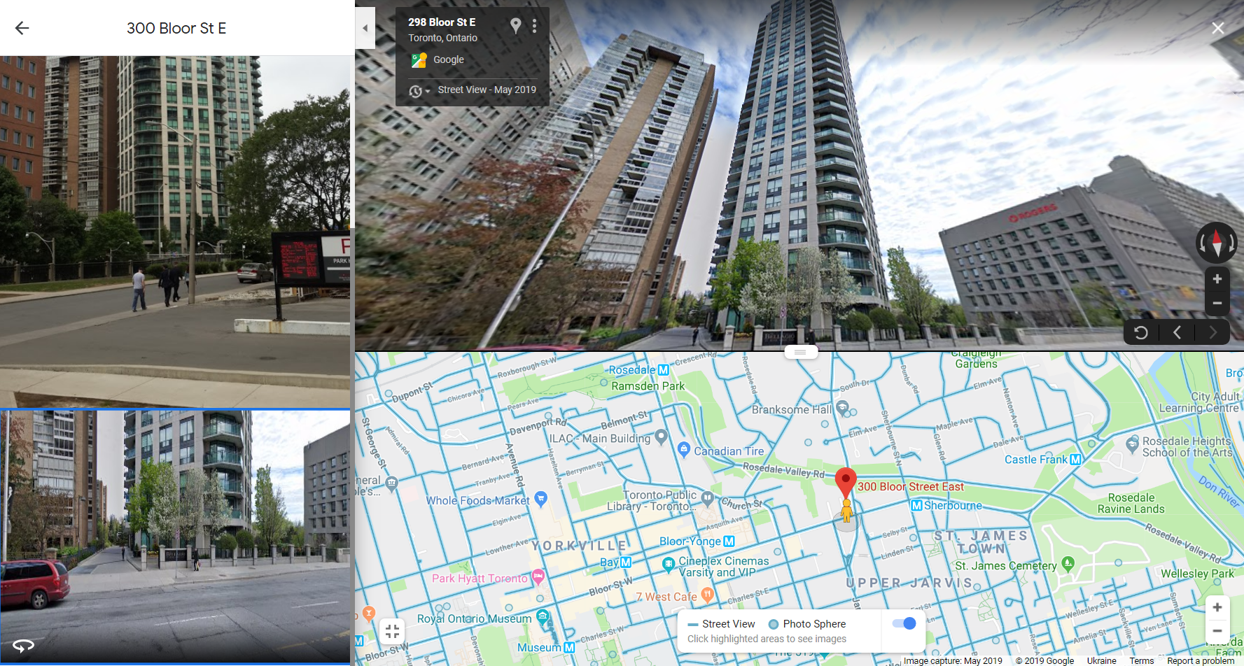
3.1: 300 Bloor St East, Toronto

Slide 20
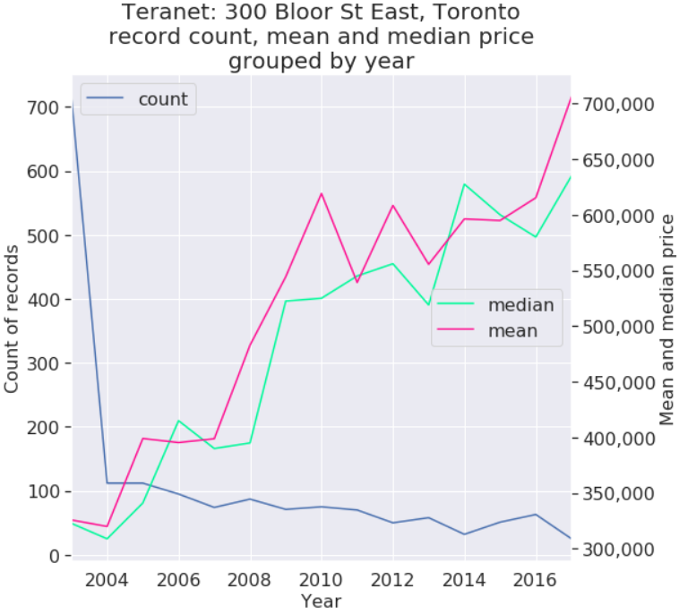
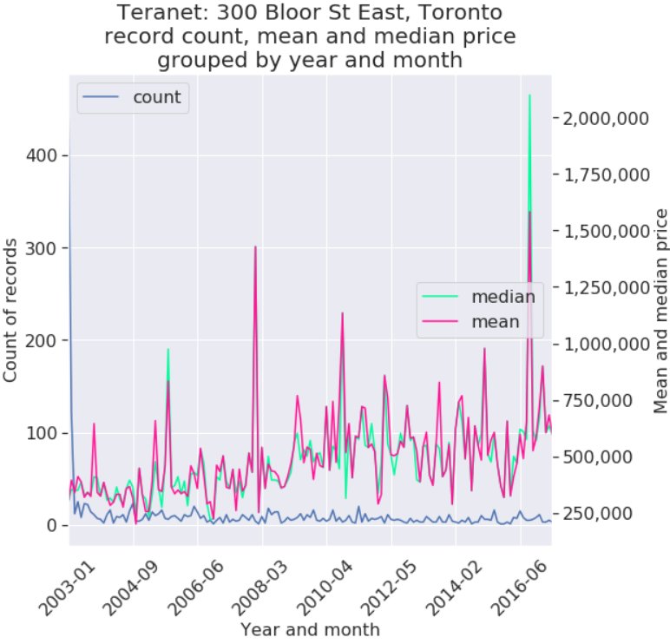
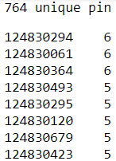
3.1: 300 Bloor St East, Toronto
Teranet record count
By pin:
By street address:
By xy:

